Slide 1

ENVIRONMENTAL MONITORING

Slide 2

NSL LABS
R.M.SUBASH NATRAYAN
ROBIN J J
MUTHUVEL M
NAVEEN KUMAR R
MUHAMED SULAIMAN A
VISHWANATHAN

Slide 3
OVER VIEW
We have used the esp32 cam which detects and monitors the fire accidents.
It also monitors the environment and activities.
These data’s are collected and sent to the other nodes which reaches the gateway.
Form the gateway the data’s are sent to the webapp.
By the help of this project we can give the fire accident data which can be easily accessible to our people.
NASA data’s from FIRMS and earthdata’s are used and displayed in the webapp.
When the fire accidents happens, our protocol will intimate the us and give the emergency warning.
We created a prototype which alerts the fire accidents and give the LIVE updates.

Slide 4



COMPONENTS
ESP 32 cam
camera
GPS
Gas sensor
ESP 32
Display
webapp
@alert
Node
ESPnow
Node
@Flow chart for fire detection and monitoring

Slide 5

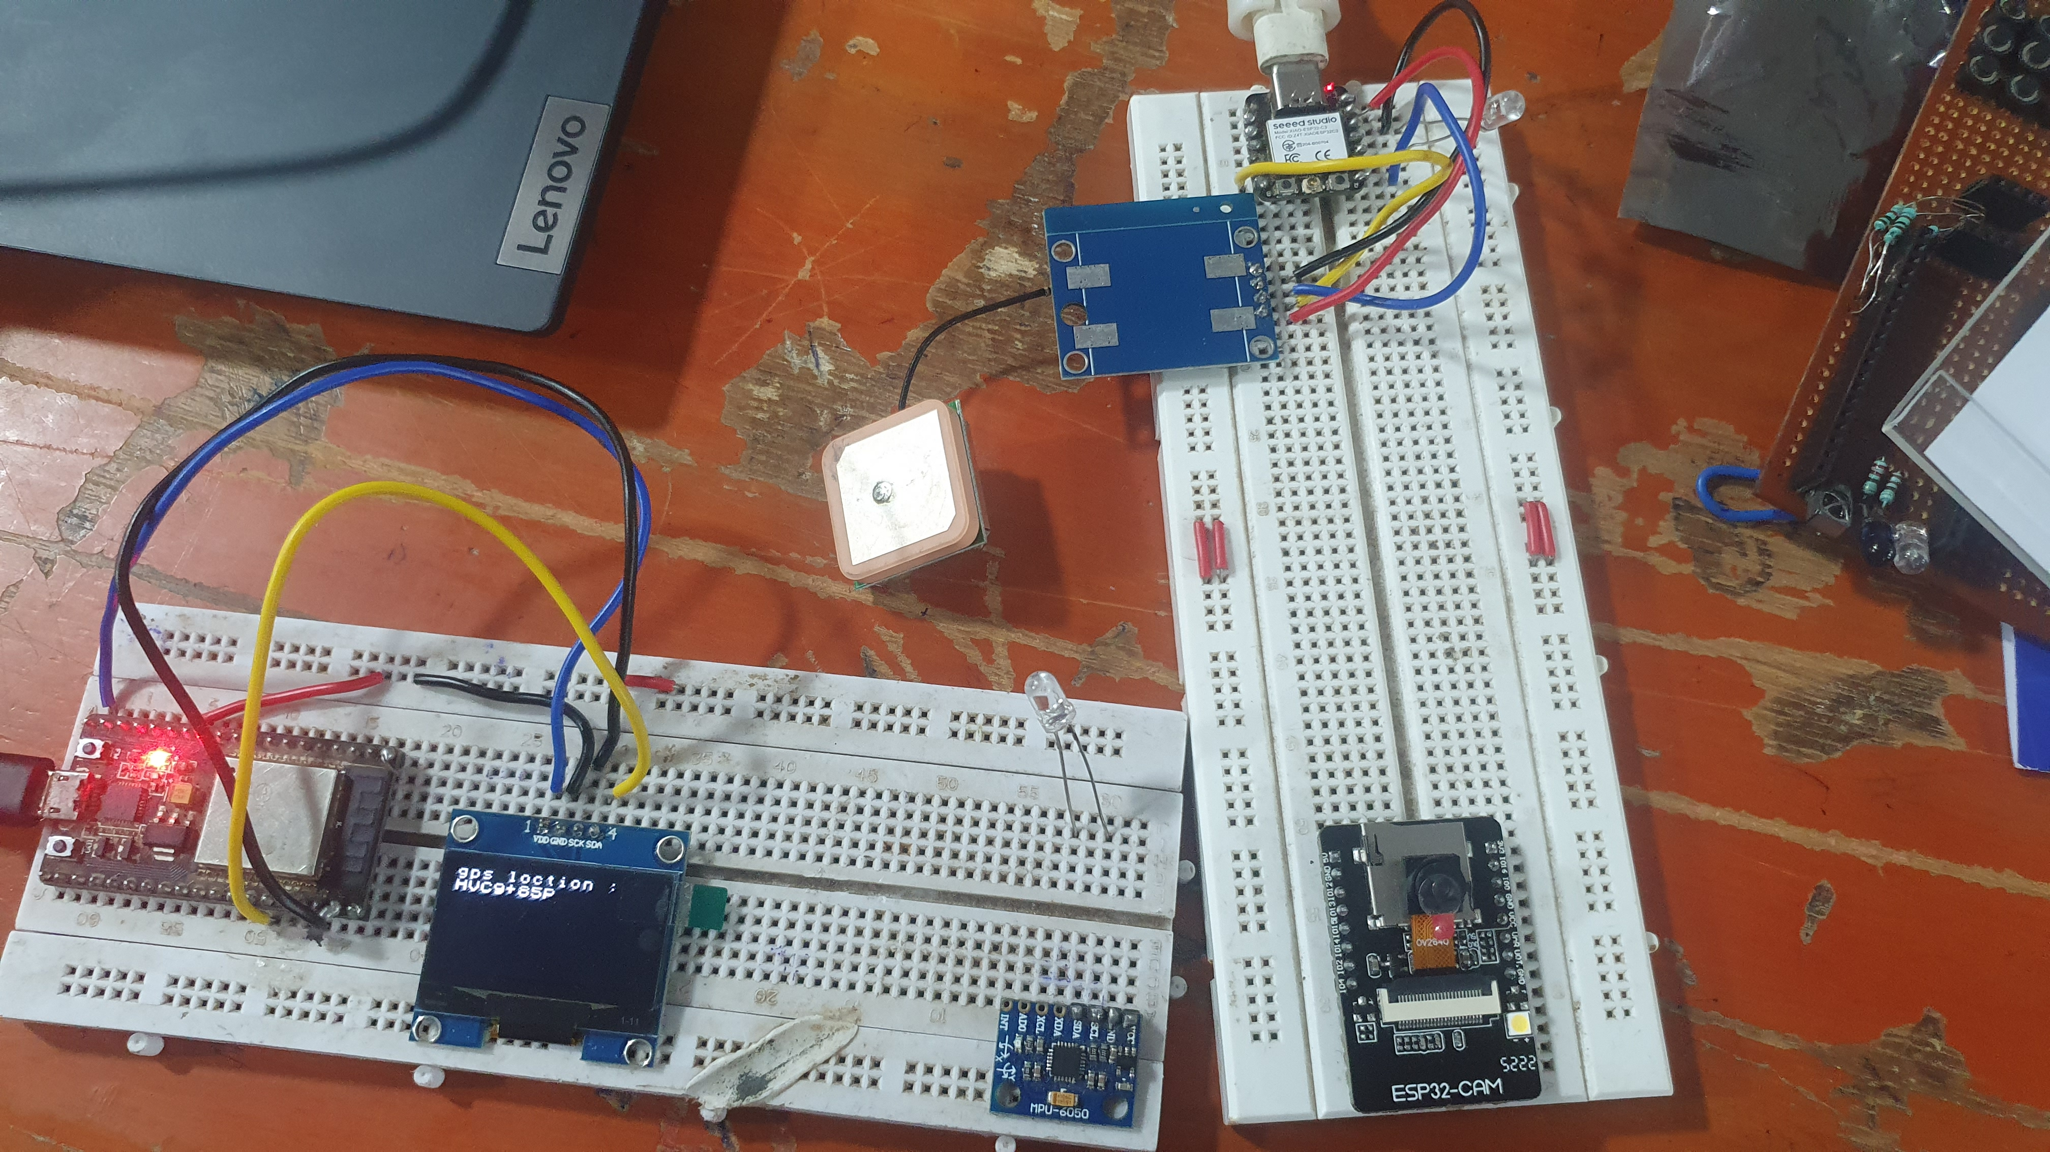
PROCESS
ESP32-CAM detects and transfers the data.
Using the gas sensor, the smoke are also detected any time.
GPS is used to give the location data.
Data’s are received by the nodeMCU.
Using espnow protocol the data is transferred.
These data’s are collected at the gateway(GSM or wifi).
Through the gateway data’s are sent to the webapp.
Data’s from the NASA’s are collected and displayed.
These data’s are now opensource and always available for our people.
It also detect the activities in the forestry areas.

Slide 6
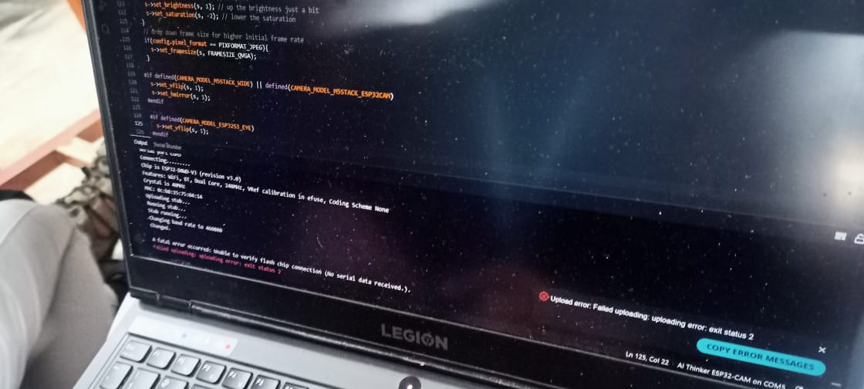
ISSUES
80% efficient but the 15% get affects by the environment and power supply.
Distance coverage is low but it detects efficiently.
5% the colour problems may occur in our prototype.
If rains signal transfer through gateway may get affected.
CHALLENGES
The difficulty we experienced is lack of components.
Because of varying supply voltage the components get affected.
Getting some network problem and we rectified it.
Getting the whole data and assigning it.

Slide 7

LEARNED
FUTURE IMPROVEMENT
Team work
Brain storming
Multi directional thinking
Content creating
Technical intelligence
Sensors knowledge
Creating own website and application to give data to our people.
Advancement using ML, the data’s can be given. It makes more efficient.
Acquiring image data’s directly from the satellite images.
With the alert, the map data also send to the fire departments.

